Slide 1

Welcome to M9!
Registration and Course Selection
Class of 2027

Slide 2
Graduation Requirements
Core Courses
Magic Number
Electives
English (4 credits)
  English 1-4
Math (4 credits)
  Algebra 1
  Geometry
  Algebra 2
  4th Math
Science (4 credits)
  Biology
  IPC, Chemistry, and/or Physics
  4th Science
Social Studies (3 or 4 credits)
  W Geo and/or W History
  US History
  Government/Economics
26
State Credits!!
Language Credits
  2 credits of SAME language
  Computer Science can count as a foreign language
Fine Arts
  One total credit
PE
  One total credit
Electives that work towards your endorsement
4 x 4
You will need 4 social studies credits if you are working towards a Multidisciplinary, or 4x4 endorsement.

Slide 3

STAAR
Algebra
Biology
English 1
English 2
US History
8th or 9th grade
9th grade
9th grade
10th grade
11th grade
You will take the STAAR exam at the end of the term that you are completing the course. If you took Algebra 1 in 8th grade, you should have already taken the Algebra EOC. You will have retake opportunities if you do not pass the first time.

Slide 4

Looking for a CHALLENGE?
Honors & AP Courses
Honors courses are for students looking to challenge themselves at a higher level
AP courses = College level work.
  Opportunity to take AP exam for college credit
Consider BALANCE
  May involve more study time outside of class
  Look at schedule as a whole - some extracurricular activities involve a heavy time commitment.
  Areas of strength and interest
Honors/AP courses require a 3 week commitment before a level-down request is considered

Slide 5


All Year Courses
AVID
AP Humanities
All year course paired with Honors English 1
College-preparatory elective course
  Organization, study skills, note taking, LEADERSHIP skills for success
FUN service projects and college field trips
Apply online
  Skyward
    Online forms
AP Human Geography paired with Honors English 1
Teaches real-world skills, study sills and prepares students for future AP classes
Students have the opportunity to take the AP exam to earn college credit.
https://drive.google.com/file/d/1lD5ZiIdXI9-HSDs98F8ltz_3V4khUXBr/view?usp=sharing

Slide 6


TECC East & TECC West
Career Center Courses
Course options that align with career options and college majors
Certification opportunities
Double blocked
  Two periods/two credits per semester. (1 & 2 or 3 & 4 periods)
    Busses run to and from TECC centers
Requests for Career Center courses are not guaranteed
Students eat lunch at Marcus 9

Slide 7
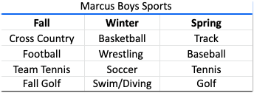
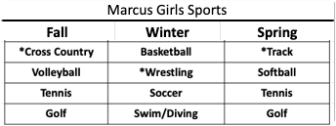
Athletics
ALL athletes MUST have a physical before participating
BEFORE and/or AFTER school practices and attendance at games is MANDATORY
Most programs require try-outs for team placement
Multi-sport athletes - Sign up for the sport that comes first during the year
  Ex: if you play football and basketball, sign up for football
  If you play volleyball and softball, sign up for volleyball
  Communication with coaches is IMPORTANT!

Slide 8
PE credit options
1 PE credit required for graduation
Athletic Teams
Cheerleading
Drill Team
Dance 2
Lifetime Fitness and Wellness
Lifetime Recreation and Outdoor Pursuits
Lifetime Activities
Band (0.5 credit)
Color Guard (0.5 credit)
JROTC

Slide 9
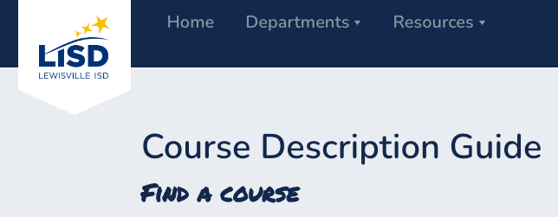
Course Description Guide
cdg.lisd.net
Helps you know about the classes you are signing up for
Understand any prerequisites and what you will be doing in the class
  Example: Technical Theatre - Uses power tools and paint to build stage props and back drops

Slide 10

Schedule Changes
Schedule Change Requests are NOT Guaranteed
Based on the courses you choose at this time, the master schedule will be built, teacher assignments will be made and seats allotted
Schedule change requests will ONLY be considered if there is an error in the schedule or program/placement changes need to be made.
  Ex: Band placement changes
  Athletic team cuts
We can not honor teacher, semester, class period or lunch requests

Slide 11
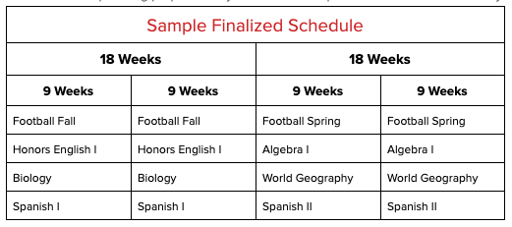
Accelerated Block Schedule
8 credits per year - 4 Fall & 4 Spring
Possible 9th Grade Schedule
4 credits in the fall and 4 credits in the spring.
Generally, each student will have 2 core classes in the fall and 2 core classes in the spring.
This may change based on elective choices.
English 1
Algebra 1
Biology
World Geography
Lifetime Activities
Latin 1 (or any language)
Latin 2 (or any language)
Tech Theatre (or other fine arts)

Slide 12
Registration Information
MS Courses for High School Credit
Choosing Alternate Electives
Courses taken for high school credit earned in middle school CANNOT be taken again at M9
Courses taken in middle school for high school credit MAY include: Algebra 1, Geometry, Spanish 1, Spanish 2, High School Art
High school courses taken in middle school do not count towards GPA.
Why do I need alternate electives??
Seat availability
Scheduling conflicts
Courses that don’t “make”
How many alternates do I need?
You need one alternate for each elective
  Art 1 = need one credit alternate
  Leadworthy = need half credit alternate
If you don’t have alternates, courses will be chosen for you.
Core classes and career center classes can NOT be alternates

Slide 13
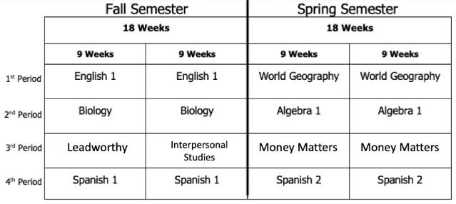
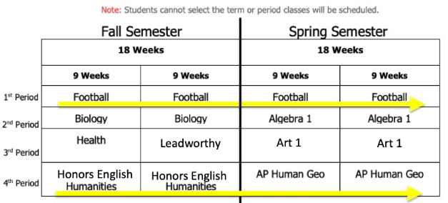
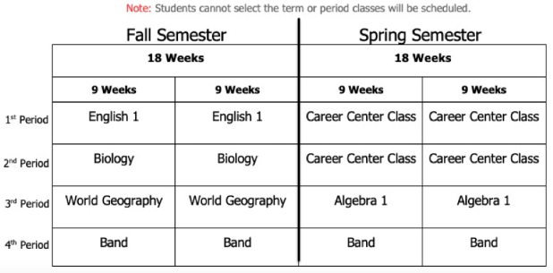
Sample Schedules
Balanced Schedule - with Language Credits
Year-long courses - Humanities and Football
Schedule with Band and Career Center *3 core classes in Fall

Slide 14
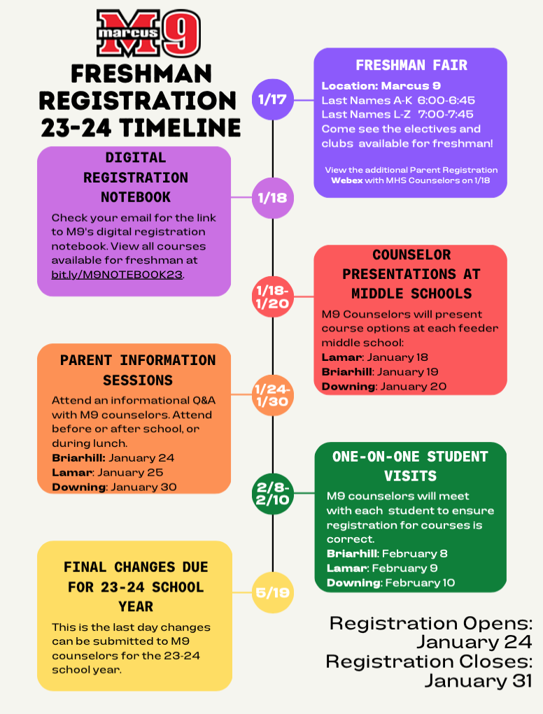
What’s Next??
Review the Registration Timeline and Registration Materials on the Marcus 9 website.
We will be visiting each of the middle schools for the following events.
Middle School Student presentations
Parent Help Sessions
Individual Student Meetings
THIS IS A GREAT TIME TO DISCUSS OPTIONS AND PLAN WITH YOUR STUDENT

Slide 15
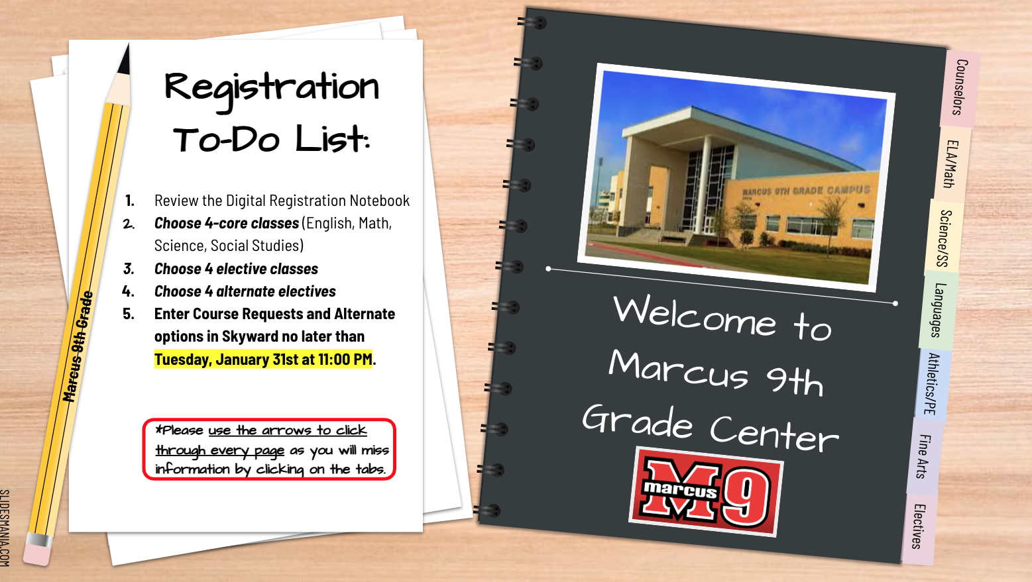
What’s Next??
Please review the Digital Registration Notebook
This will be emailed to all parents and students on January 18th. All resources will be available on the M9 Counseling website.

Slide 16
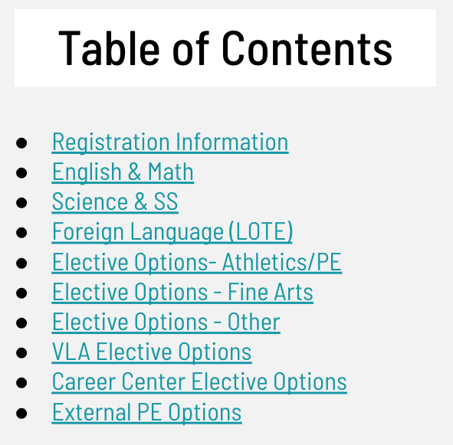
What’s Next??
The Digital Notebook includes:
Core Course information
Elective information
Links and videos
Athletics
Fine Arts
Career Center
Contact information for M9 counselors
SKYWARD ACCESS OPENS: January 24 @ 8 am
SKYWARD ACCESS CLOSES: January 31 @ 11 pm
*Enter student’s requests in Skyward using the STUDENT’S LOGIN (*Parent logins will be view only)

Slide 17

WE ARE LOOKING FORWARD TO A GREAT YEAR!
THANK YOU!

Slide 19

Sample Schedules
First
Next
Type something here.
Last
Type something here.

Slide 20
Accelerated Block Schedule
Type something here.
Type something here.
Type something here.
Type something here.
Type something here.
Type something here.
Type something here.
Type something here.
Type something here.
Type something here.
Type something here.
Type something here.
Type something here.
Type something here.
Type something here.
Type something here.

Slide 21
All Year
What do I know?
What do I wonder?
What have I learned?
Type something here.
Type something here.
Type something here.

Slide 22
Add a title here.
Type something here.
Level II Title
Level II Title
Level II Title
Level II Title
Type something here.
Type something here.
Type something here.
Type something here.

Slide 23
Cause and Effect.
Cause
Effect #1
Type something here.
Type something here.
Effect #2
Type something here.
Effect #3
Type something here.

Slide 24
Collect evidence and write your conclusion.
Evidence #1
Conclusion
Type something here.
Type something here.
Evidence #2
Type something here.
Evidence #3
Type something here.

Slide 25
Frayer Model.
Type something here.
Type something here.
Word
Type something here.
Type something here.

Slide 26
Class debate.
Name
Name
Name
Type a statement here
Name
Name
Name
Grab a post it, type your name and place it on the board.

Slide 27
Add a title here.
Title One
Title Two
Type something here.
Type something here.
Title Three
Title Four
Type something here.
Type something here.

Slide 28
Bingo!
Type something here.
Type something here.
Type something here.
Type something here.
Type something here.
Type something here.
x
Type something here.
Type something here.
Type something here.
Type something here.
Type something here.
Type something here.
x
Type something here.
Type something here.
Type something here.
Type something here.
Type something here.
Type something here.
x

Slide 29
Accelerated Block Schedule
Add a kinesthetic activity
Add a visual activity
Add an auditory activity
Add a read / write activity
Add an auditory activity
Add a read / write activity
Add a kinesthetic activity
Add a visual activity
Add a visual activity
Add a kinesthetic activity
Add a read / write activity
Add an auditory activity
Add a read / write activity
Add an auditory activity
Add a visual activity
Add a kinesthetic activity

Slide 30
Something A
Something I
Something B
Final Round!
Something J
Something B
Something J
Something J
Something C
Something K
Something C
Something K
Something D
Something L
Something E
Something M
Something F
Something N
Something G
Something O
Something H
Something P

